Slide 1
Analytics for Audit
Introduction

Slide 2



Slide 3
Mentor
Grow
Basic

Slide 4
Outline
Background
Problem
Objectives
Content
Activities
Quiz

Slide 5
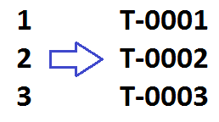

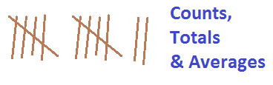
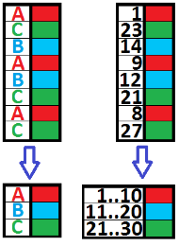
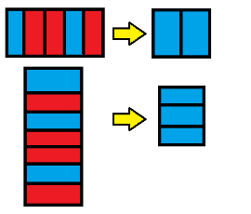
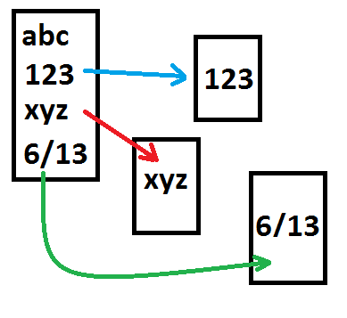

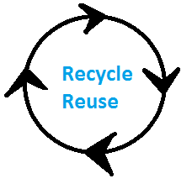

1 | 2 | 3
4 | 5 | 6
7 | 8 | 9
Collect | Confirm | Change
Choose | Combine | Condense
See | Collaborate | Automate
Collect | Confirm | Change
Choose | Combine | Condense
See | Collaborate | Automate

Slide 6


Slide 7


Slide 8
Collect | Confirm | Change
Choose | Combine | Condense
See | Collaborate | Automate

Slide 9


Slide 10


